Slide 1
Subordinating Conjunctions

Slide 2
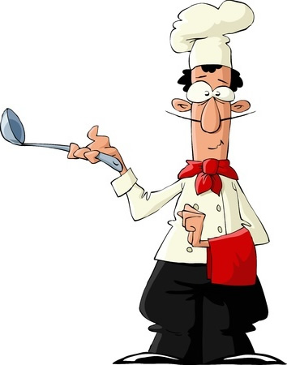
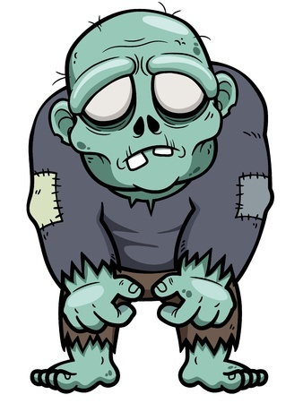
Subordinating Conjunctions
Join clauses and make complex sentences
Examples
The paperboy lost the sports section again because he is the worst.
If you have one scoop of my soup, you will demand a second.
OMG, even though it’s 90 degrees out, I think that you look so cute in that sweater.

Slide 3
Commonly Used Subordinating Conjunctions
Although, after, as, as soon as, because, before, even if, even though, if, once, since, so that, than, that, though, unless, until, when, whenever, where, whereas, wherever, whether, while
There are a few others ones too

Slide 4
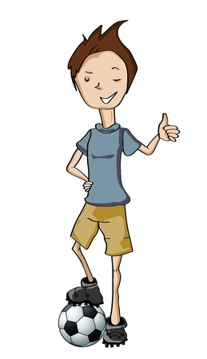
Warning: Many Subordinating Conjunctions Do Other Things
You have to look at how it’s being used
Brian is going home after practice because he needs to eat dinner.
Brian is going home to eat dinner after soccer practice ends.
Subordinating conjunctions join clauses.

Slide 5
More Examples of Subordinating Conjunctions
Boss Yoko wants the money that you promised him and I’m here to collect it.
Which word in the above sentence is working as a subordinating conjunction?
that

Slide 6
More Examples of Subordinating Conjunctions
If you don’t want to hear the sound of me click-clackin’ around here anymore then you’re welcome to swim home.
Which word in the above sentence is working as a subordinating conjunction?
If

Slide 7
More Examples of Subordinating Conjunctions
As soon as the bell rings, we’re going to try that new skate ramp, bro.
Which word in the above sentence is working as a subordinating conjunction?
As soon as

Slide 8
Review
Subordinating conjunctions join clauses and make complex sentences.
Careful: words that are subordinating conjunctions can do other things.
Always check how the word is used.

