Slide 1

Singular, Plural, and Possessive
Nouns

Slide 2
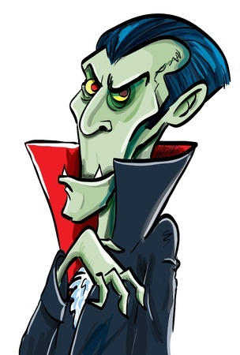


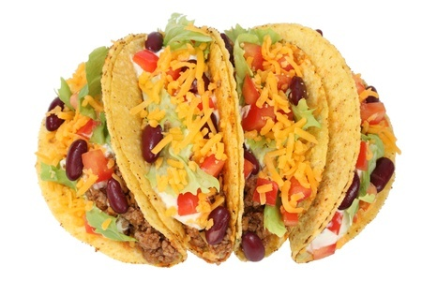
Nouns
People, places, and things
Examples
tacos
Italy
Count Dracula
dreams

Slide 3
Singular Noun
One person, place, or thing.
Ex: Oh no, I missed the bus again.
Plural Noun
More than one person, place, or thing.
Ex: I don’t like busses anyway.

Slide 4
Pluralizing Nouns
Usually, just add an -s.
Ex: hat => hats
Sometimes add -es
If the word ends with an -s, -ss, -sh, -ch,
-x, or –z (and most words that end in -o).
Ex: kiss => kisses
Sometimes remove the -y and add -ies
If the word ends in a consonant and a y.
Ex: baby => babies

Slide 5
Pluralizing Nouns (continued)
Sometimes leave the -y alone and just add -s
If the word ends in a vowel followed by -y
Ex: boy => boys
Sometimes remove the -f or -fe and add -ves
Words like wolf, loaf, and wife follow this rule.
Ex: knife => knives
Some words have different forms
Words like mice, teeth, and feet.
Ex: child => children

Slide 6
Who Cares?
Some people judge you when you spell words incorrectly.
Learning how to pluralize nouns will help you spell words correctly.
CCSS.ELA-LITERACY.CCRA.L.2: Demonstrate command of the conventions of standard English capitalization, punctuation, and spelling when writing.

Slide 7
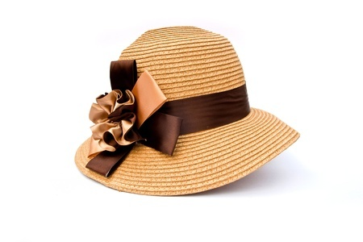
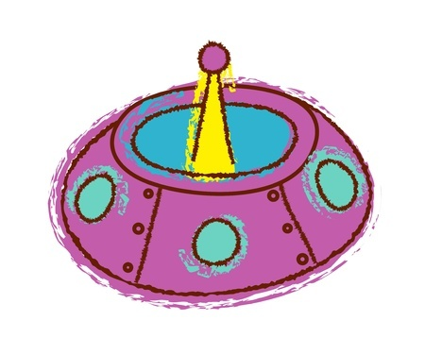

Possessive Nouns
Show possession or ownership.
Grandma’s hat has a big flower on it.
We’re going for a ride in Zerg’s spaceship.
Did you complete today’s assignment?
The apostrophe indicates possession.
What else can an apostrophe do?

Slide 8
Making Possessive Nouns
Usually just add an apostrophe and an -s.
Ex: Bob => Bob’s
But, with words that end in a -z sound, just add an apostrophe.
Ex: students => students’
cars => cars’
Flanders => Flanders’

Slide 9

Examples of Singular, Plural, and Possessive Nouns
We went to Super Jamie’s headquarters.
Is Super Jamie’s a singular,
plural or possessive noun?
Possessive Noun

Slide 10
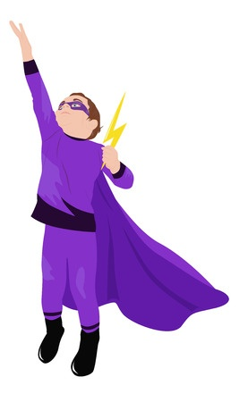
Examples of Singular, Plural, and Possessive Nouns
Captain Kevin can make tornadoes appear out of thin air.
What about Captain Kevin,
tornadoes, and air? Singular, plural
or possessive nouns?
Singular Noun
Plural Noun
Singular Noun

Slide 11
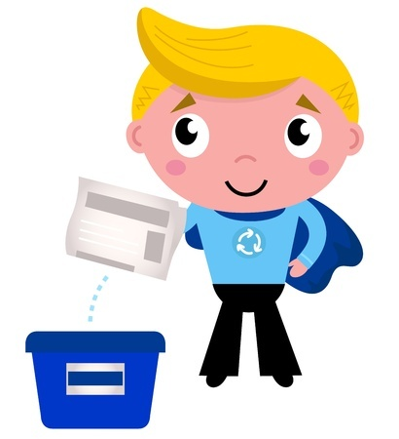
Examples of Singular, Plural, and Possessive Nouns
Super Chris’s power is to save the Earth.
How about Super Chris’s
and Earth? Are they singular,
plural or possessive nouns?
Possessive Noun
Singular Noun

Slide 12
Review
One person, place, or thing is singular.
Two or more is plural.
Usually, just add an -s to pluralize, but
sometimes add -es, or drop the -y and add -ies.
Possessive nouns show ownership.
Add an apostrophe to the noun and an -s if the
word doesn’t end in a z sound.

