Slide 1
Pronouns and Antecedents

Slide 2
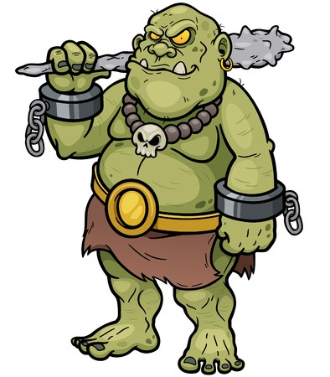
Pronouns
Take the place of nouns
Example
Gorlock forgot his club in his other loincloth, so he had to make a new one.
What do his and he refer to in the above sentence?

Slide 3
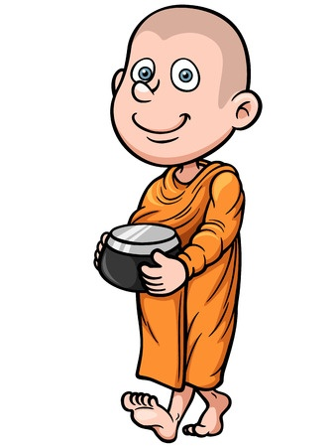
Why Pronouns?
Brother Kung fed some of Brother Kung’s rice to the birds while Brother Kung walked to Brother Kung’s temple.
What’s this sentence missing?
Brother Kung fed some his rice to the birds while he walked to his temple.

Slide 4
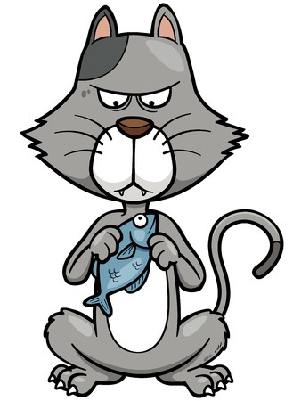
Antecedents
The nouns to which pronouns refer
Mr. Tickles normally did not eat fish without organic soy sauce, be he decided to make an exception.
To which noun does the word he refer?
Mr. Tickles is the antecedent of he.

Slide 5
Don’t Use Vague Pronouns
When the antecedent of the pronoun is unclear, the pronoun is vague.
Example
Brian got mad when his dog ran through the mud because he was wearing his best suit.

Slide 6
Examples of Pronouns and Antecedents
The students saw the long lunch line and began worrying that they wouldn’t have time to eat.
What’s the pronoun in the above sentence? What’s the antecedent?
they / students

Slide 7
Examples of Pronouns and Antecedents
OMG! General Krag looks like ten-thousand years younger with his spots polished.
What’s the pronoun in the above sentence? What’s the antecedent?
his / General Krag

Slide 8
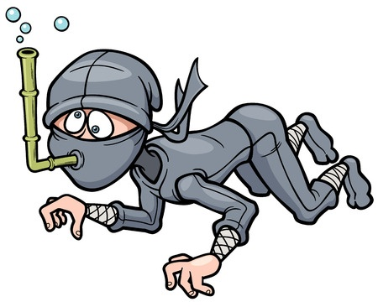
Examples of Pronouns and Antecedents
White Lotus was unfamiliar with the bamboo snorkel and nearly drowned while learning how to use it.
What is the pronoun in the above sentence? What is the antecedent?
it / bamboo snorkel

Slide 9
Review
Pronouns take the place of nouns.
Pronouns make language less clunky.
Antecedents are the nouns to which pronouns refer.
Make sure that your antecedents are clear to avoid using vague pronouns.

