Slide 1
Pronoun Case and Perspective

Slide 2
Subjects and Objects
Nouns that take verbs are subjects
Nouns that do not take verbs are objects
Captain Jones waved around his saber and threatened the landlubbers.
Which noun is the subject?

Slide 3
Pronoun Case
Some pronouns change form based on whether they are subjects or object
I taught myself to skateboard because nobody else would teach me.
When do we use I? When do we use me? When do we use myself?

Slide 4
Who Cares?
You sound more intelligent when you choose the correct pronoun case.
Don’t you want to sound more intelligent?
CCSS.ELA-LITERACY.CCRA.L.1: Demonstrate command of the conventions of standard English grammar and usage when writing or speaking.

Slide 5
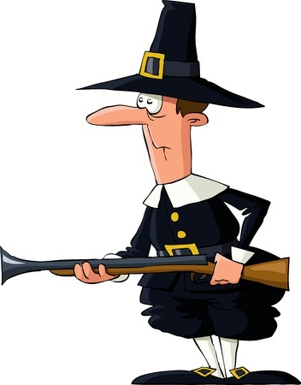
Subjective Pronouns
Personal pronouns that take a verb
I, we, you, he, she, they, them, it
Example
When we arrived in the new country, we were bearing gifts for the natives.

Slide 6
Objective Pronouns
Personal pronouns that do not take verbs
Me, us, you, it, him, her, them
Example
The natives were delighted to meet us.

Slide 7
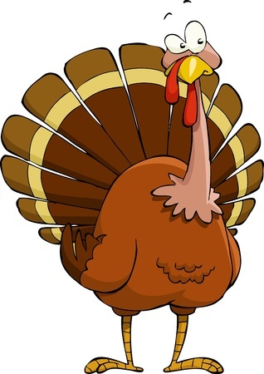
Reflexive Pronouns
Must refer or reflect on the subject
Myself, ourselves, yourself, yourselves, himself, herself, themselves, itself
Example
Tommy the Turkey didn’t want to be by himself anymore so he was happy to be invited to our table.

Slide 8
Choosing the Right Pronoun
Use subjective pronouns as subjects and objective pronouns as objects
Slow down and ask yourself, “Did I do this, or did it happen to me?”
Examples
Jed and I went to the swimming hole.
The teacher gave me and Karen a hall pass.
She is taller than I.

Slide 9
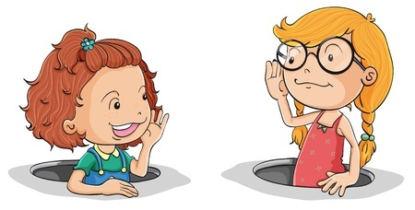
Pronoun Perspective
First, second, or third-person
First-Person
I, me, my, myself, we, our, ours, ourselves
Second-Person
You, your, yours, yourself, yourselves
Third-Person
He, she, it, him, her, his, hers, himself, herself, itself, they, them, their, theirs, themselves

Slide 10
Case and Perspective Chart
 | Subjective | Objective | Reflexive
First-Person | I, we | me, us | myself, ourselves
Second-Person | you | you | yourself, yourselves
Third-Person | he, she, they, it, | him, her, them, it | himself, herself, themselves, itself

Slide 11
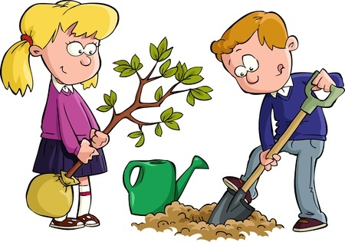
More Examples of Pronoun Case
My Dad and _______ were planting a tree for Earth Day.
Do we need a subjective or objective pronoun?
Subjective

Slide 12
More Examples of Pronoun Case
Alyssa was pleased when the teacher put ______ and Ahmad in a group.
Do we need a subjective or objective pronoun?
Objective

Slide 13
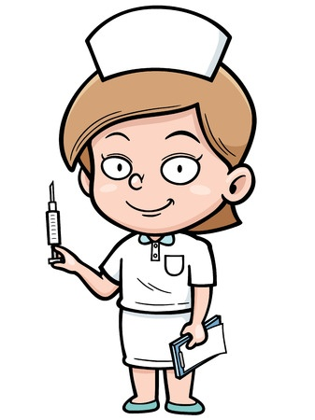
More Examples of Pronoun Case
The patient tried to run from Nurse Christie but ______was faster than ______.
Do we need a subjective or objective pronoun?
Subjective

Slide 14
Review
Subjective pronouns take verbs.
Objective pronouns do not take verbs.
Reflexive pronouns reflect on the subject.

