Slide 1
Prepositions

Slide 2
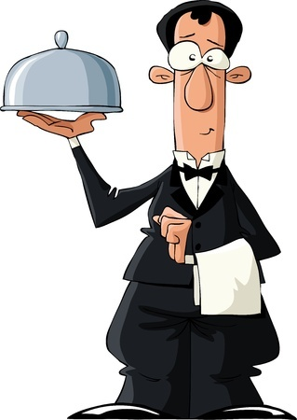
Prepositions
Show relationships between nouns and other words
Examples
I have a bowl of cereal inside this dish for you.
I will serve cherry slushy to you after supper.

Slide 3
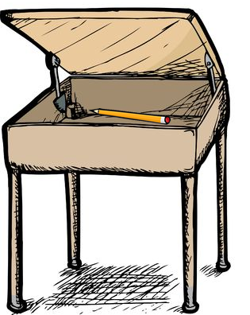
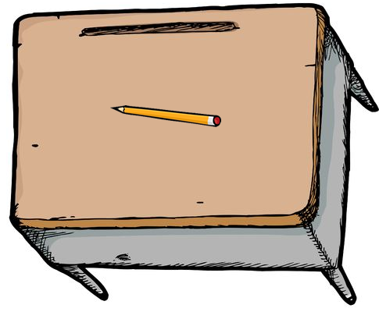
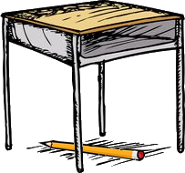
Prepositions Show Positions
Where is the pencil in relation to the desk?
The pencil is on the desk.
The pencil is underneath/below the desk.
The pencil is inside the desk.

Slide 4
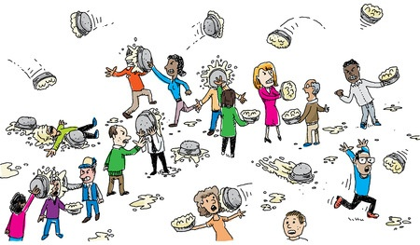
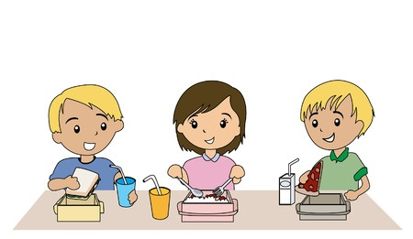
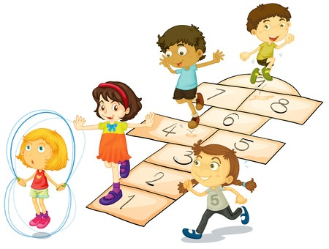
Prepositions Show Positions in Time Too
Recess is before lunch.
Recess is after lunch.
Recess is during lunch.

Slide 5
Common Prepositions
About, above, across, after, against, along, around, as, at, before, behind, below, beneath, beside, between, beyond, by, down, during, except, for, from, in, inside, into, like, near, next, of, off, on, out, outside, over, past, since, through, throughout, till, to, toward, under, underneath, unlike, until, up, upon, with, within, without

Slide 6
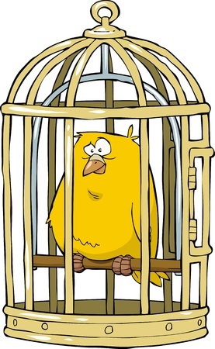
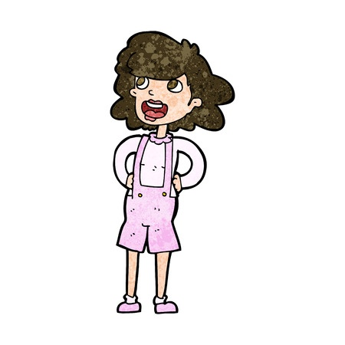
Remove Redundant Prepositions
Some prepositions are not needed
Examples
Where did you go to school at?
The fat yellow bird was inside of the cage.
Captain Katrina did not know where her dog went to.

Slide 7
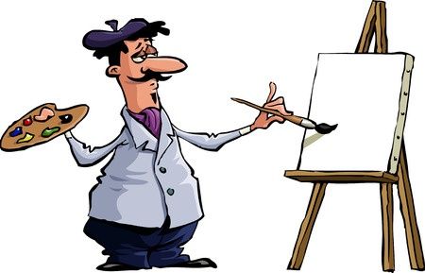
More Examples of Prepositions
I will paint a masterpiece on this blank canvas.
Which word in the above sentence is a preposition?
on

Slide 8
More Examples of Prepositions
DJ Jamie Green is performing at the pool party.
Which word in the above sentence is a preposition?
at

Slide 9
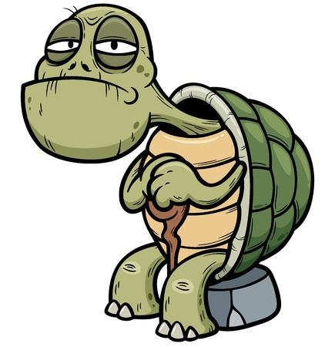
More Examples of Prepositions
I’ll hide inside of my shell if it gets too dangerous.
Which preposition in the above sentence should be removed?
of

Slide 10
Review
Prepositions show relationships between nouns and other words.
Prepositions often show the positions of nouns in time and space.
Avoid using redundant or unnecessary prepositions

