Slide 1
Irregular Adverbs

Slide 2
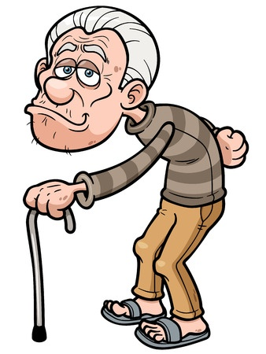
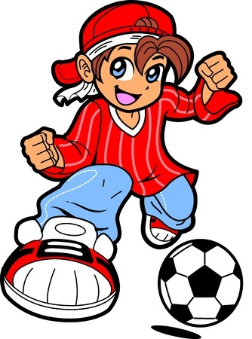
Adverbs
Describe or modify verbs, adjectives, and other adverbs, and they usually end in -ly
Example: The ball goes exactly where Diego wants it to go.
Irregular Adverbs
Do not end in -ly
Example: You’re too old to learn to breakdance, Gerald, but maybe you could still get into krumping.

Slide 3
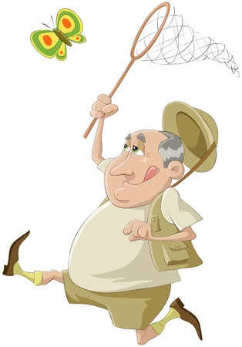
Flat Adverbs
Adverbs that are spelled the same as their adjective forms (no -ly)
Example
Harold is not known for being fast, but he does run fast when he’s chasing butterflies.
More Flat Adverbs: far, hard, high, late, long, low, right, straight, wrong

Slide 4
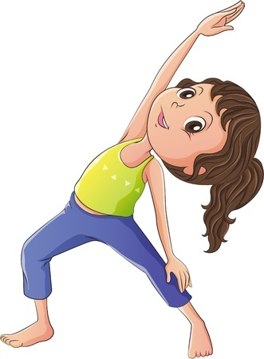
Irregular Adverbs of Degree
Modify frequency or intensity and do not end in -ly
Example
Nina is very flexible.
More Examples: about, almost, altogether, downright, enough, just, least, less, mighty, more, most, pretty, quite, rather, so, somewhat, still, too, very, yet

Slide 5
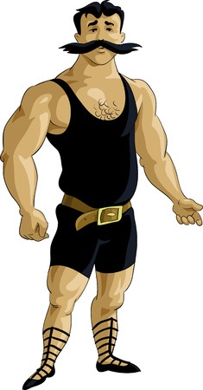
Negatives Can Be Adverbs
Words like not and never are adverbs
Example
That muscleman from the circus was not dressed fashionably.

Slide 6
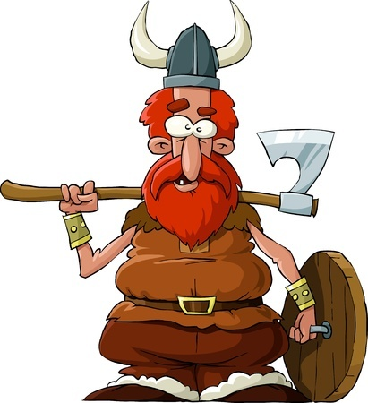
Good and Well
Good is an adjective and well is an adverb
Things are good, but one does a thing well.
Examples
Erik the Red is a good at pillager.
Erik the Red pillages well.

Slide 7
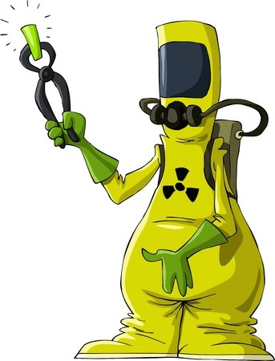
Examples of Irregular Adverbs
Working with plutonium can be quite dangerous.
Which word is an adverb and what type of word is it modifying?
quite
dangerous / adjective

Slide 8
Examples of Irregular Adverbs
OMG, Jenna! That zombified teddy bear is so cute!
Which word is an adverb and what type of word is it modifying?
so
cute / adjective

Slide 9
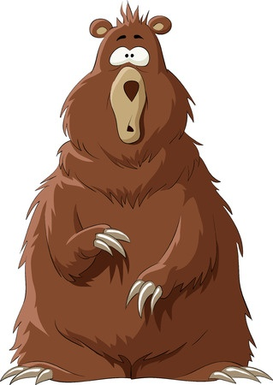
Examples of Irregular Adverbs
That wily bear couldn’t believe it when he saw those ducks floating down the river in an armored boat tank.
Which word is an adverb and what type of word is it modifying?
n’t
believe / verb

Slide 10
Review
Adverbs that do not end in -ly are irregular.
Flat adverbs are identical to their adjective forms.
Adverbs that describe frequency or intensity often don’t end in -ly.

