Slide 1
Conjugating Verbs

Slide 2
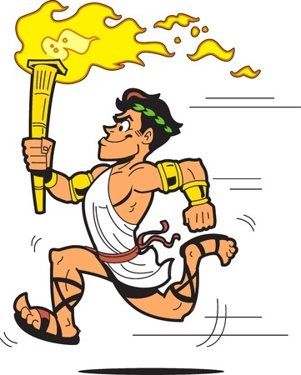
Conjugate
Change the form of a verb
Example
run
run => runs
run => ran
run => will be running
Why are there different forms of run?

Slide 3
Verbs Show Time
Conjugation shows when actions occur
Example
Kendra played basketball.
Kendra plays basketball.
Kendra will play basketball.
We call this verb tense.

Slide 4
Verb Tense
Shows whether actions take place in the past, present, or future
To Form the Past Tense
Add -ed to the verb (usually).
Ex: jump => jumped
To Form the Future Tense
Add will or “be” going to.
Ex: jump => will jump
jump => is going to jump

Slide 5
The Subject and Verb Must Agree
Verbs change to agree with the subject (the noun that takes the verb)
Examples
Brian the Brainblob drools acid.
Brainblobs drool acid.
Why?
In the simple-present tense, when the sentence has a singular third-person subject, add an -s to the verb.

Slide 6
Keep Your Eye on the Subject
The verb must agree with the subject
Students who pay attention to the teacher [ is / are ] going to learn more than students who fall asleep.
The subject is the noun that takes the verb.

Slide 7
Helping Verbs Must Agree Too
Based on the perspective of the subject
 | 1st-Person Singular | 1st-Person Plural | 2nd Person | 3rd-Person Singular | 3rd-Person Plural
Past | I was | We were | You were | He / she / it was | They were
Present | I am | We are | You are | He / she / it is | They are
Future | I am going to be | We are going to be | You are going to be | She / he / it is going to be | They are going to be

Slide 8
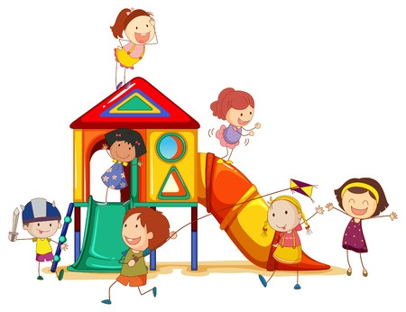
Statements Contrary to the Fact
Use the helping verb were instead of was
Examples
If I were principal, recess would be after lunch and before lunch.
Watch for wish and if

Slide 9
Conjugation Shows Completion
Verbs can show whether an action has been completed or is ongoing
Example
The boys were finishing their project.
The boys have finished their project.
We call this aspect.

Slide 10
Simple Aspect
Simply in the past, present, or future
Simple Past
Krag conquered the planet Crouton.
Simple Present
Krag conquers the planet
Crouton.
Simple Future
Krag will conquer the
planet Crouton.

Slide 11
Progressive Aspect
An action that was, is, or will be in progress
Past Progressive
Brother Tao was meditating.
Present Progressive
Brother Tao is meditating.
Future Progressive
Brother Tao will be meditating.
Progressive Aspect Always Has:
Helping verb + verb + ing

Slide 12
Perfect Aspect
Referring to a completed action or event
Past Perfect
Squirrel had already packed his bags.
Present Perfect
Squirrel has already packed his bags.
Future Perfect
Squirrel will have already packed his bags.
Perfect Aspect Always Has:
Have, has, or had + past participle

Slide 13
Irregular Verbs
Some verbs are hard to conjugate
For example: see
 | Simple | Progressive | Perfect
Past | I saw. | I was seeing. | I had seen.
Present | I see. | I am seeing. | I have seen.
Future | I will see. | I will be seeing. | I will have seen.

Slide 14
Examples of Tense and Aspect
Milo the Monkey King was tumbling in the Tumtum tree.
What is the tense and aspect of the above sentence?
Past Progressive

Slide 15
Examples of Tense and Aspect
Kung has mastered the deadly art of the flying frog.
What is the tense and aspect of the above sentence?
Present Perfect

Slide 16
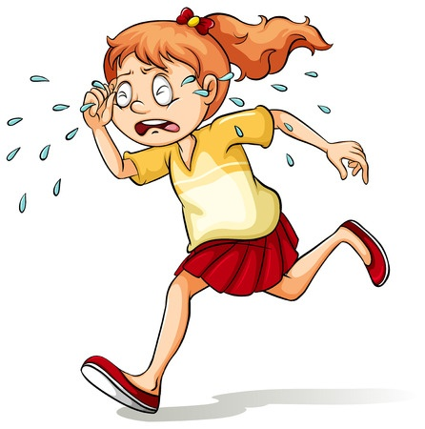
Examples of Tense and Aspect
I’ll be crying in my room.
What is the tense and aspect of the above sentence?
Future Progressive

Slide 17
Review
Verbs are conjugated to agree with the subject and to express time.
Verbs show when things happen and if these actions have been completed.
Progressive aspect is for actions that were, are, or will be in progress.
Perfect aspect is for referring to completed actions from the past, present, or future.

