Slide 1

Articles

Slide 2
Articles
Adjectives that introduce nouns
a
an
the

Slide 3

Definite Article
Introduces a specific noun or nouns
Example
When the tortoise and the hare
raced again, the hare won easily.
The only definite article is the.

Slide 4
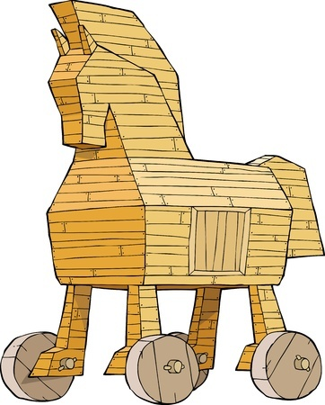
Indefinite Article
Introduces a general noun or nouns
Example
Hey, the Trojans got us a gift!
The indefinite articles are
a and an.

Slide 5


When to Use A and An
Use an before a word that begins with a vowel sound.
Example: Kung is an honorable warrior
who fears nothing.
Use a before all other words.
Example: Kung turned into a hideous zombie.

Slide 6

More Examples of Articles
Bro, Bradley just pulled off _____ coolest trick that I’ve ever seen.
Which article would
best complete the sentence?
the

Slide 7

More Examples of Articles
Don was digging ____ hole in the front yard for some reason.
Which indefinite article would best complete the sentence?
a

Slide 8

More Examples of Articles
Keisha wanted to get ____ SAT score that would open doors for her.
Which indefinite article would
best complete the sentence?
an

Slide 9
Review
Articles introduce nouns.
Indefinite articles introduce general nouns.
Definite article introduces specific nouns.

