Slide 1

Adverbs

Slide 2
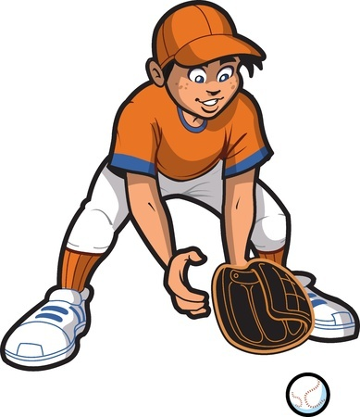
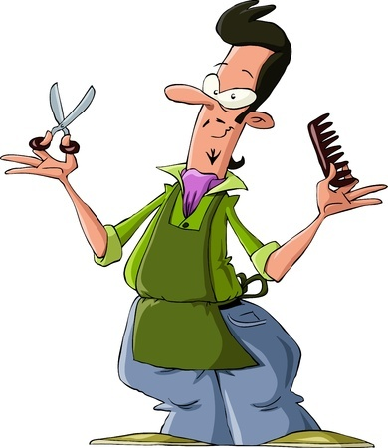
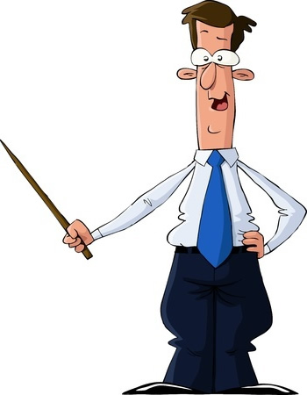
Adverbs
Describe or modify verbs, adjectives, and other adverbs
Examples
Mr. Morton spoke confidently
about the subject.
Jean Philip is the most talented
hairstylist at Cheap Clips.
Conner has to move really
quickly if he want to make this play.

Slide 3
Turning Adjectives into Adverbs
Add -ly to the end of most adjectives
Beautiful => Beautifully
Intelligent => Intelligently
For adjectives that end in a y, drop the y and add -ily
Noisy => Noisily
Happy => Happily

Slide 4

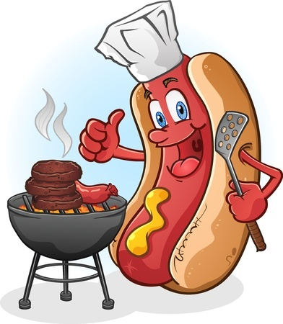
Good and Well
Good is an adjective and well is an adverb
Examples
Argh! I could not read well
even when I had two eyes.
Mmm, that hotdog is going
to be good when it’s done.

Slide 5
Be Careful With Senses
Check to see if you are modifying a noun or a verb before using your modifier
Example
You smell good / well
You smell good means that someone has a pleasant odor.
You smell well means that someone is skilled at perceiving odors with their nose.

Slide 6

More Examples of Adjectives
The loud and unruly customer was even more annoyed when Patricia politely responded to his complaints.
Which word is an adverb
and what type of word
is it modifying?
politely / verb

Slide 7
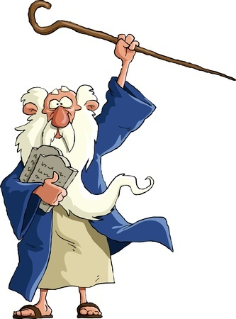
More Examples of Adjectives
The textbooks that the district provides may be really old, but they still work.
Which word is an adverb
and what type of word
is it modifying?
really / adjective

Slide 8

More Examples of Adjectives
Dr. Simmons was studying the explosive chemicals very carefully.
Which word is an adverb
and what type of word
is it modifying?
carefully / verb
very / adverb

Slide 9
Review
Adverbs modify verbs, adjectives, and other adverbs
Adverbs can be made from most adjectives by adding -ly.
Adjectives that end with -y, drop the y and add -ily.

