Slide 1

Adjectives

Slide 2

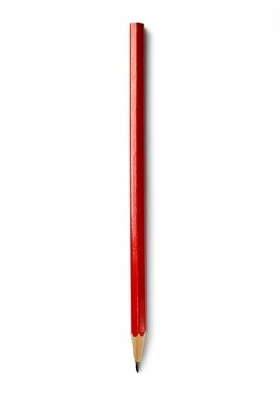
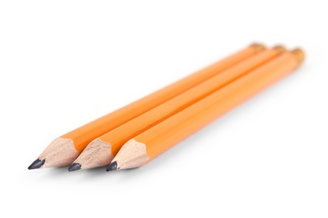
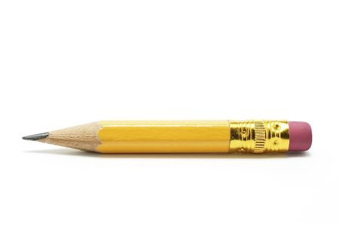
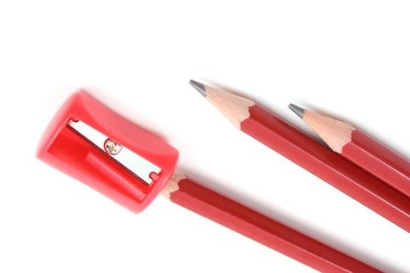
Adjectives
Describe or modify nouns and pronouns
Examples
pencil
short pencil
red pencil
three pencils
three red pencils

Slide 3
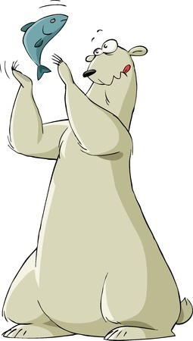
More Examples of Adjectives
The clumsy polar bear almost
dropped the slippery fish.
Which words function as
adjectives in the above sentence?
clumsy
slippery

Slide 4

More Examples of Adjectives
Female anglerfish use bright lights to attract their prey.
Which words function
as adjectives in the
above sentence?
female
bright

Slide 5
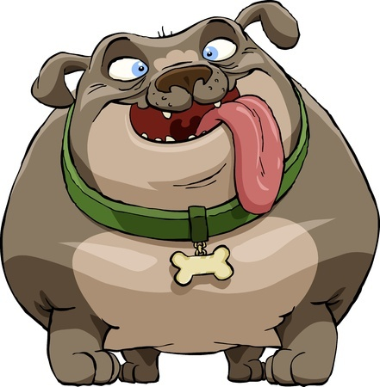
More Examples of Adjectives
Fat dogs are happier than skinny dogs.
Which words function as
adjectives in the above
sentence?
fat
skinny
happier

Slide 6
Review
Adjectives describe or modify nouns and pronouns.
Adjectives commonly describe things like color, size, and number.

