Slide 1
Types of Pronouns

Slide 2
Seven Types of Pronouns
Personal
Possessive
Reflexive
Relative
Demonstrative
Indefinite
Interrogative

Slide 3
Personal Pronouns
Take the place of nouns
The Personal Pronouns:
I, me, us, we, you, he, him, she, her, it, them, they
Example
Colonel Mustard was invited to the party at Mrs. Witherspoon’s mansion, but he didn’t want to go alone.

Slide 4
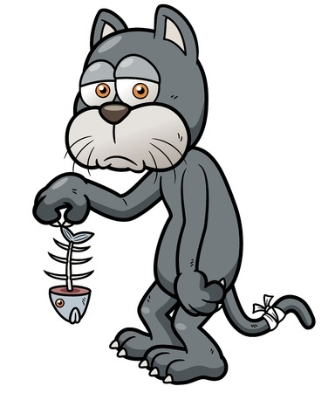
Possessive Pronouns
Take the place of possessive nouns
The Possessive Pronouns:
My, mine, our, ours, your, yours, his, her, hers, their, theirs, its
Example
Mr. Whiskers was disappointed with his dinner.

Slide 5
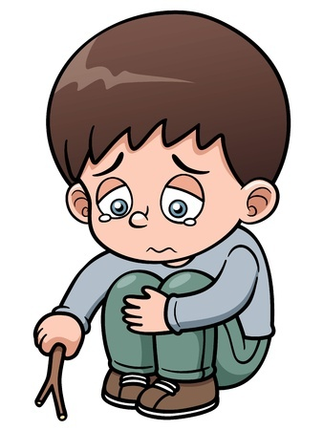
Reflexive Pronouns
Refer or reflect back to the subject
The Reflexive Pronouns:
Myself, ourselves, yourself, yourselves, himself, herself, themselves, itself
Example
Andre just wanted to be by himself.

Slide 6
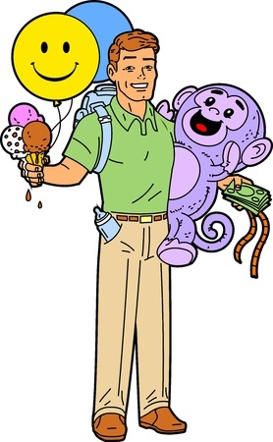
Use Reflexive Pronouns Carefully
They can only be used after a name or pronoun to which they refer.
Don’t
My children wanted to go to Happyland with myself.
Do
My children wanted to go to Happyland with me, but I wanted to go by myself.

Slide 7
Relative Pronouns
Introduce relative clauses
The Relative Pronouns:
That, who, whom, whose, which, whoever, whomever, whichever
Example
The pirate captain, who had never seen the inside of a schoolroom, struggled to read the ransom note.

Slide 8
Relative Clauses
Begin with a relative pronoun and give more information about a noun.
Examples
Willard, who had just learned of the sun’s power, used a magnifying glass to terrorize ants.
Ants that are exposed to magnified sunlight tend to combust.

Slide 9
Demonstrative Pronouns
Take the place of things
The Demonstrative Pronouns:
This, that, these, those
Example
“This is my favorite book about unicorns,” said Patrick.

Slide 10
Indefinite Pronouns
Take the place of unspecified nouns
The Indefinite Pronouns:
Another, all, any, anybody, anyone, anything, both, each, either, enough, everybody, everyone, everything, few, fewer, less, little, many, more, most, much, neither, none, nothing, one, other, others, several, some, somebody, someone, something, such
Example
Office Ramirez heard something moving behind the dumpster.

Slide 11
Interrogative Pronouns
Take the place of things
The Interrogative Pronouns:
Who, whom, what, which, whose
Example
What’s inside of that treasure chest?

Slide 12
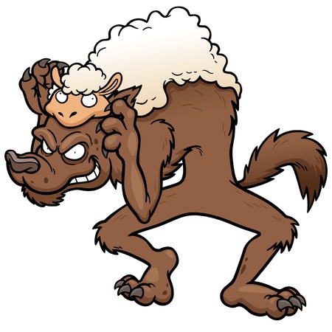
Examples of Pronouns
The wolf covered himself in sheepskin and attempted to sneak into the shepherd's flock.
Which word is a pronoun in the above sentence? What type of pronoun is it?
himself / reflexive

Slide 13
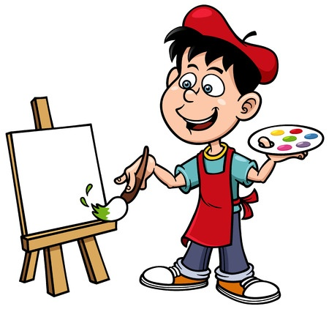
Examples of Pronouns
Jean Paul is going to paint something that will revolutionize the art world.
Which word is a pronoun in the above sentence? What type of pronoun is it?
something / indefinite

Slide 14
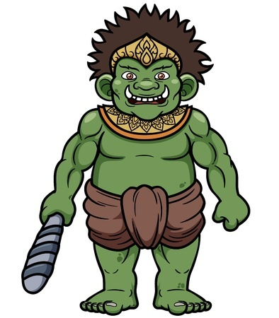
Examples of Pronouns
Trolleisha wore a new dead animal skin so that Gorlock would notice her.
Which word is a pronoun in the above sentence? What type of pronoun is it?
her / personal

Slide 15
Review
Personal, possessive, and reflexive pronouns usually fill in for people’s names.
Relative pronouns introduce relative clauses, which give more information about nouns.
Indefinite pronouns fill in for unknown or unspecified people, places, things.

