Slide 1

Subordinating Conjunctions

Slide 2

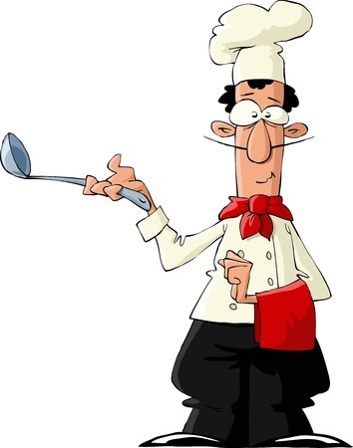
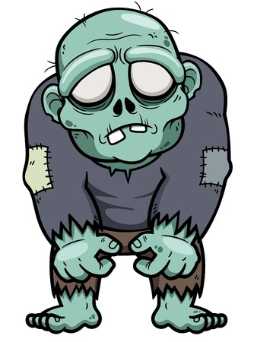
Subordinating Conjunctions
Join clauses and make complex sentences
Examples
The paperboy lost the sports section
again because he is the worst.
If you have one scoop of my soup, you
will demand a second.
OMG, even though it’s 90 degrees out,
I think that you look so cute in that sweater.

Slide 3
Commonly Used
Subordinating Conjunctions
Although, after, as, as soon as, because, before, even if, even though, if, once, since, so that, than, that, though, unless, until, when, whenever, where, whereas, wherever, whether, while
There are a few others ones too

Slide 4
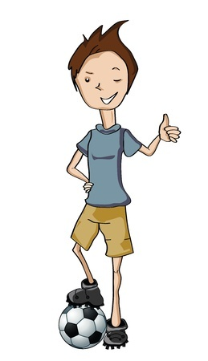
Warning: Many Subordinating Conjunctions Do Other Things
You have to look at how it’s being used
Brian is going home after practice
because he needs to eat dinner.
Brian is going home to eat dinner
after soccer practice ends.
Subordinating conjunctions
join clauses.

Slide 5

More Examples of
Subordinating Conjunctions
Boss Yoko wants the money that you promised him and I’m here to
collect it.
Which word in the above
sentence is working as a
subordinating conjunction?
that

Slide 6

More Examples of
Subordinating Conjunctions
If you don’t want to hear the sound of me click-clackin’ around here
anymore then you’re welcome
to swim home.
Which word in the above
sentence is working as a
subordinating conjunction?
If

Slide 7

More Examples of
Subordinating Conjunctions
As soon as the bell rings, we’re going to try that new skate ramp, bro.
Which word in the above
sentence is working as a
subordinating conjunction?
As soon as

Slide 8
Review
Subordinating conjunctions join clauses and make complex sentences.
Careful: words that are subordinating conjunctions can do other things.
Always check how the word is used.

