Slide 1

Pronouns and
Antecedents

Slide 2
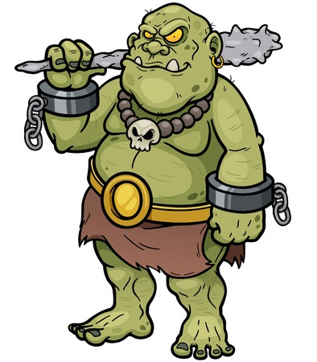
Pronouns
Take the place of nouns
Example
Gorlock forgot his club
in his other loincloth, so
he had to make a new one.
What do his and he refer to in
the above sentence?

Slide 3
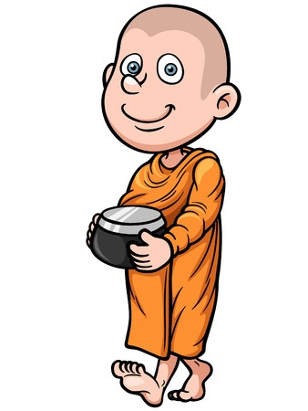
Why Use Pronouns?
Brother Kung fed some of Brother
Kung’s rice to the birds while
Brother Kung walked to Brother
Kung’s temple.
What’s this sentence missing?
Brother Kung fed some his rice to the
birds while he walked to his temple.

Slide 4
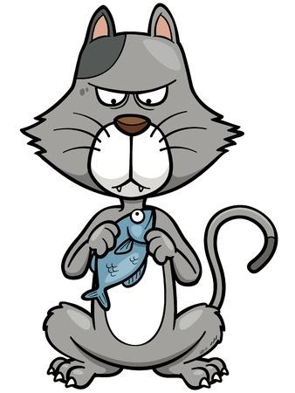
Antecedents
The nouns to which pronouns refer
Mr. Tickles normally did not eat
fish without organic soy sauce,
be he decided to make an
exception.
To which noun does the word
he refer?
Mr. Tickles is the antecedent
of he.

Slide 5

Don’t Use Vague Pronouns
When the antecedent of the pronoun is unclear, the pronoun is vague.
Example
Brian got mad when his dog ran
through the mud because he was
wearing his best suit.

Slide 6

Examples of Pronouns and Antecedents
The students saw the long lunch line and began worrying that they wouldn’t have time to eat.
What’s the pronoun in the
above sentence? What’s
the antecedent?
they / students

Slide 7

Examples of Pronouns and Antecedents
OMG! General Krag looks like ten-thousand years younger with his spots polished.
What’s the pronoun in the
above sentence? What’s
the antecedent?
his / General Krag

Slide 8
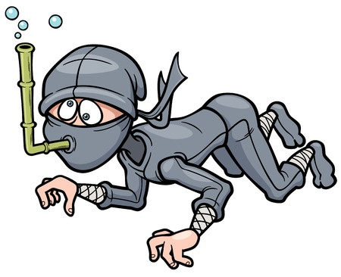
Examples of Pronouns and Antecedents
White Lotus was unfamiliar with the bamboo snorkel and nearly drowned while learning how to use it.
What is the pronoun in the
above sentence? What is
the antecedent?
it / bamboo snorkel

Slide 9
Review
Pronouns take the place of nouns.
Pronouns make language less clunky.
Antecedents are the nouns to which pronouns refer.
Make sure that your antecedents are clear to avoid using vague pronouns.

