Slide 1
Prepositional Phrases

Slide 2
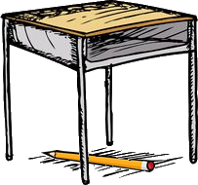
Prepositions
Words that show relationships between nouns and other words
Examples
The pencil is under the desk.
The desk is inside the classroom.

Slide 3
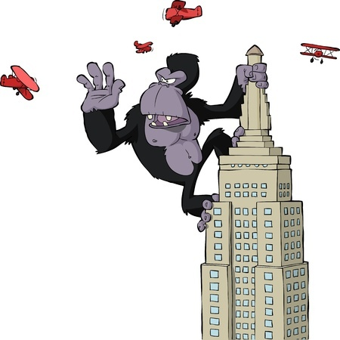
Objects
Nouns in a sentence that do not take an action or predicate
Example
A giant monkey has climbed to the top of a tall building and is swatting down planes.

Slide 4
Prepositional Phrase
A preposition, an object, and the words that connect them
Examples
The doctor gave Satya a shot in her arm.
Brad’s idea of a good time is sitting on the couch.

Slide 5
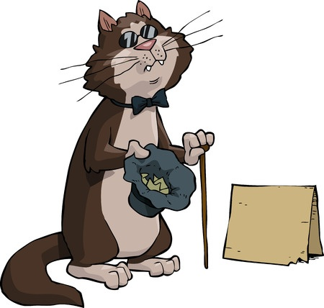
No Subjects and No Predicates
Prepositional phrases only include a preposition, an object, and modifiers
Examples
I’m going with Valerie to the mall.
The cat with the black bowtie is begging for snacks again.

Slide 6
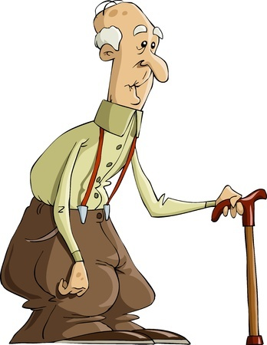
More Examples of Prepositional Phrases
Arthur lost his good teeth under the couch, so he’ll be having soup again.
What is the complete prepositional phrase used in the above sentence?
under the couch

Slide 7
More Examples of Prepositional Phrases
Shawn can do a front flip on his bike, bro.
What is the complete prepositional phrase used in the above sentence?
on his bike

Slide 8
More Examples of Prepositional Phrases
Hey, we should get an expensive gift for our teacher since he or she helps us so much.
What is the complete prepositional phrase used in the above sentence?
for our teacher

Slide 9
Review
Prepositions show relationships between nouns and other words.
Prepositional phrases start with a preposition and include an object, modifiers, and any words that connect them.
Prepositional phrases do not include subjects or predicates.

