Slide 1
Interjections

Slide 2
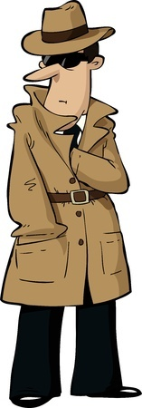
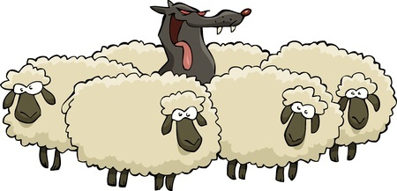
Interjections
Words that express excitement or emotion
Examples
Uh, Harry, is that you?
Pssst! The crow flies at midnight.
Interjections are followed by a comma, ellipsis, or an exclamation point.

Slide 3
Some Common Interjections
Ahh
Argh
Ew
Hey
Hmm
Huh
Ohh
Whew
Yikes

Slide 4
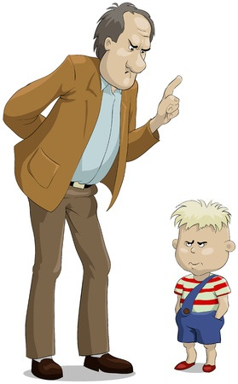
Interjections Are Nonstandard
You should only use interjections for dialogue in formal writing.
An Example of Dialogue
Dad said, “Argh! How could you eat my special chocolate bar?”
Dialogue is when characters in a story speak to each other.

Slide 5
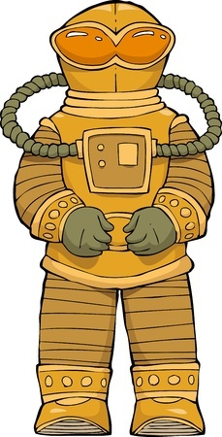
More Examples of Interjections
Shelly cried in terror, “Eek! Invaders from space are invading!”
Which word in the above sentence is an interjection?
Eek

Slide 6
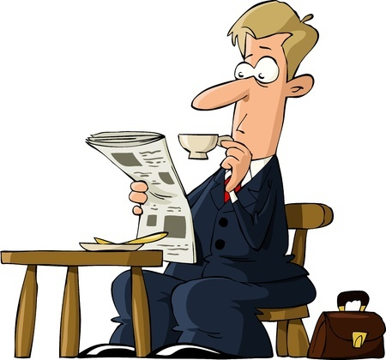
More Examples of Interjections
Mr. Witherspoon read the day’s news, sipped his tea, and said to himself in dismay “Tsk, tsk, what has happened to this world?”
Which word in the above sentence is an interjection?
Tsk

Slide 7
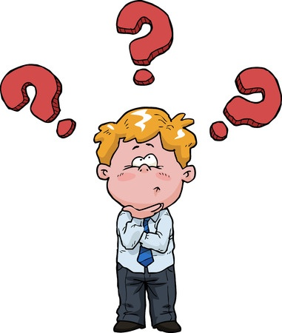
More Examples of Interjections
Bobby wondered to himself, “Why do ostriches have feathers if they can’t fly? Hmm…”
Which word in the above is an interjection?
Hmm

Slide 8
Review
Interjections show excitement or emotion.
Interjections are one word utterances that are inappropriate for formal writing.
Interjections are always followed by a comma, ellipsis, or exclamation point.
Dialogue is an appropriate place to use interjections.

