Slide 1

Coordinating Conjunctions

Slide 2
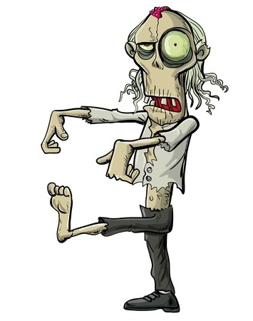
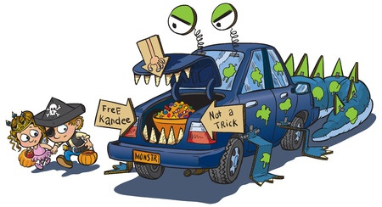
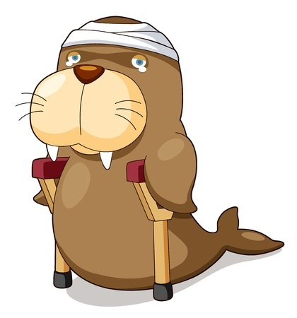
Coordinating Conjunctions
Join words, phrases, and clauses
Examples
Max and Mae were tempted by the sign that said “Free Kandee.”
Hey, guys, I’m going to run home
really quickly and eat some brains.
Wally the Walrus may have fallen
of the iceberg and shattered his
tail bone but he’ll be fine.

Slide 3
The Coordinating Conjunctions
There are 7 coordinating conjunctions
You can remember them with F.A.N.B.O.Y.S.
For
And
Nor
But
Or
Yet
So

Slide 4
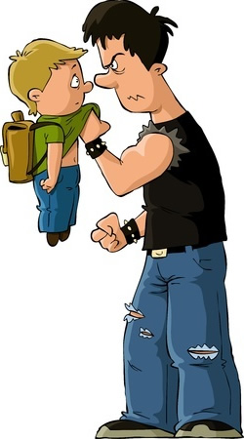
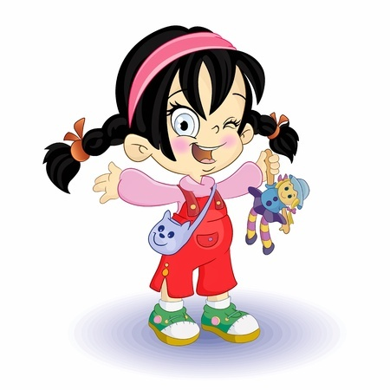
Be Careful of BFYS
But, for, yet, and so can be other parts of speech too
Adverbs
I’m so excited!
I haven’t told anyone else yet.
Prepositions
I need you to do my homework for me.
Why did you invite everyone to your birthday
party but me?

Slide 5
So How Can You Tell?
Look at what the word is doing
Ask Yourself:
Is it joining two clauses?
Is it connecting groups of nouns?
Is it one of the F.A.N.B.O.Y.S.?
It’s probably a coordinating conjunction!

Slide 6

More Examples of
Coordinating Conjunctions
Some people know that file sharing is illegal but do it anyway.
Which word in the above
sentence is acting as a
coordinating conjunction?
but

Slide 7

More Examples of
Coordinating Conjunctions
I haven’t had my coffee yet so you’ll
have to excuse my tone.
Which word in the above
sentence is acting as a
coordinating conjunction?
SO
yet is working like an adverb

Slide 8
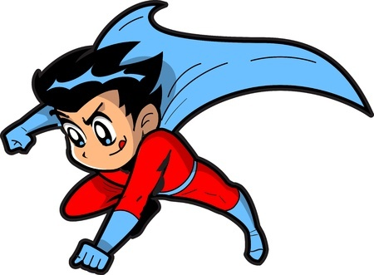
More Examples of
Coordinating Conjunctions
Hero Boy fights for truth, beauty, and healthy cafeteria food.
Which word in the above
sentence is acting as a
coordinating conjunction?
and
for is working as a preposition

Slide 9
Review
Coordinating conjunctions join words, phrases, and clauses.
F.A.N.B.O.Y.S. will help you remember the 7 coordinating conjunctions.
B.F.Y.S. can also be adverbs and prepositions, so be careful!

