Slide 1
Comparative and Superlative Adjectives

Slide 2
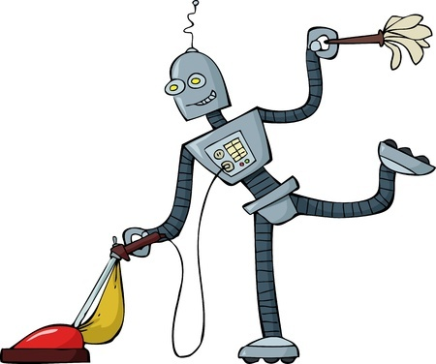
Adjectives
Describe or modify nouns and pronouns
Examples
The helpful robot cleaned my room.
He’s friendlier than that killer robot that tried to eradicate humanity.

Slide 3
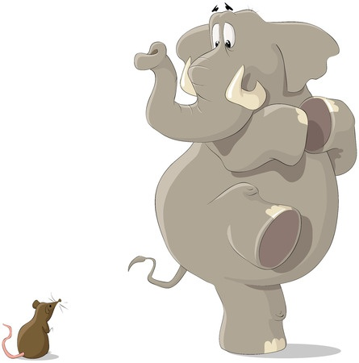
Comparative Adjectives
Compare two things
Example
Elephants are bigger than mice, but size isn’t everything.

Slide 4
Making Comparative Adjectives
Usually just add -er to the adjective.
fast => faster
If the adjective ends with a -y, drop the -y and add -ier (usually).
tidy => tidier
If the word is longer than 2 syllables, don’t add anything. Use the word more.
intelligent => more intelligent

Slide 5
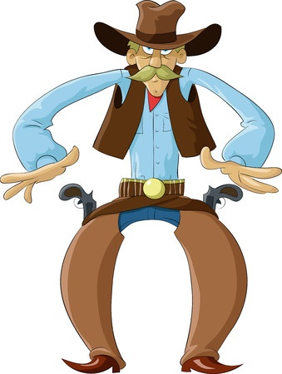
Superlative Adjectives
Used in comparisons and represents the greatest or highest degree
Example
Lightning Bill Bradley has the fastest draw in the West.

Slide 6
Making Superlative Adjectives
Usually just add -est to the adjective.
fast => fastest
If the adjective ends with a -y, drop the -y and add -iest (usually).
tidy => tidiest
If the word is longer than 2 syllables, don’t add anything. Use the word most.
intelligent => most intelligent

Slide 7
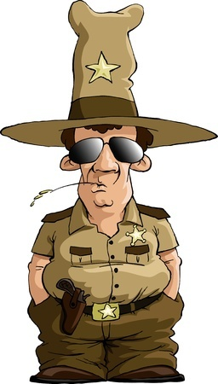
More Examples of Comparative and Superlative Adjectives
Officer Burberry is shorter than most of the other police officers on the force.
Which word is an adjective in the above sentence, and is it comparative or superlative?
shorter = comparative

Slide 8
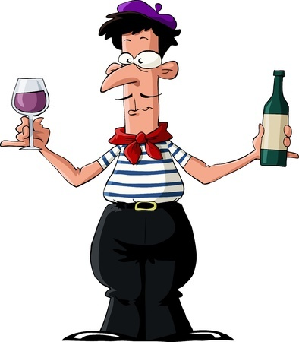
More Examples of Comparative and Superlative Adjectives
When Jean Pierre heard that Claudette was coming to his apartment, he put on his fanciest scarf.
Which word is an adjective in the above sentence, and is it comparative or superlative?
fanciest = superlative

Slide 9
More Examples of Comparative and Superlative Adjectives
Bertha is taller than Brandon but Brian is the tallest student in our class.
Which word is a comparative adjective and which is a superlative?
taller = comparative
tallest = superlative

Slide 10
Review
Comparative adjectives compare two things.
Superlative adjectives compare a thing to others, and express that it is of the highest degree.
Adjectives that have more than two syllables take more or most.

