Slide 1

Common & Proper Nouns

Slide 2
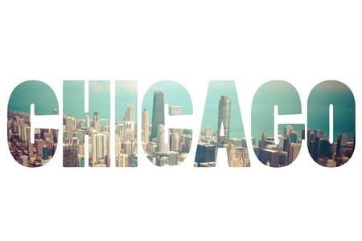


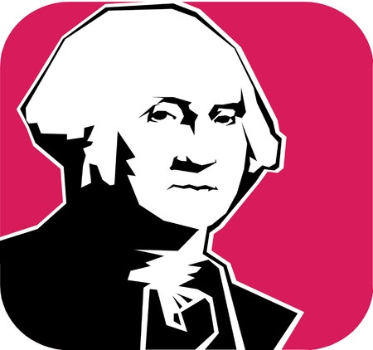
Nouns
People, places, and things
Examples
rocks
Chicago
George Washington
freedom

Slide 3
Common Nouns
A general person, place, or thing
Ex: What book are you reading?
Proper Nouns
A specific person, place, or thing.
Ex: I am reading “The Lord of the Flies.”

Slide 4
Who Cares?
Proper nouns are ALWAYS capitalized!
Learning the difference between proper and common nouns will help you write in standard English.
CCSS.ELA-LITERACY.CCRA.L.2: Demonstrate command of the conventions of standard English capitalization, punctuation, and spelling when writing.

Slide 5
Common vs. Proper Nouns
month
June
soda
Diet Coke
movie / book
The Hunger Games
holiday
Labor Day
student
George
Common nouns are general.
Proper nouns are specific.

Slide 6
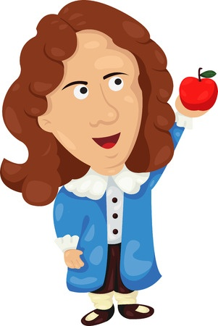
More Examples of Common and Proper Nouns
Newton's First Law of Motion states that an object in motion remains in motion unless force is applied to it.
Is Newton’s First Law of Motion
a common or proper noun?
Proper Noun

Slide 7
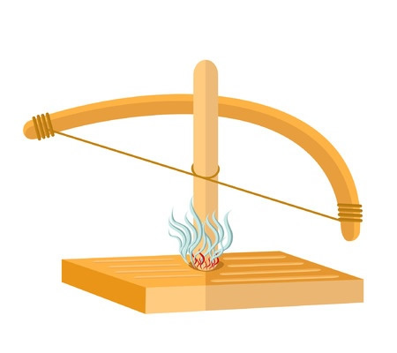
More Examples of Common and Proper Nouns
Friction causes heat.
Is friction a common or proper noun?
Common Noun

Slide 8
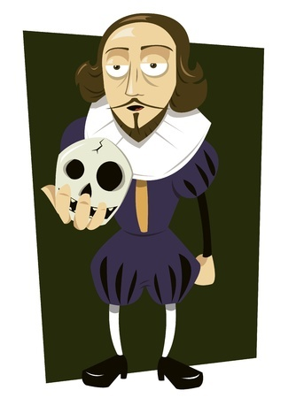
More Examples of Common and Proper Nouns
William Shakespeare is my favorite playwright.
Does this sentence have a
common noun or a proper noun?
Both!

Slide 9
Review
Proper nouns are specific people, places, and things.
Common nouns are generalized people, places, and things.
You should always capitalize people’s names and titles, holidays, product names, the names of geographic features, dates, appropriate words in titles… Capitalize specific people, places, and things.

