Slide 1

Clauses

Slide 2
Vocabulary for This Lesson
Predicate
Subject
Object
Clause
Compound Predicate
Compound Subject
Independent Clause
Dependent Clause

Slide 3
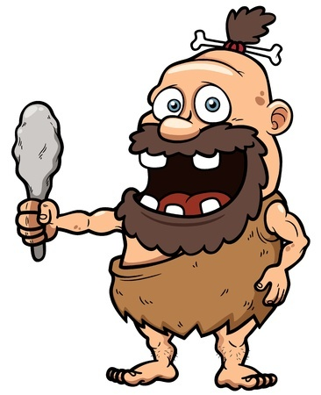
Predicate
Verb or action in a sentence
Examples
Oog found a new club by
the tar pit.
Ogg was excited about his new
club.

Slide 4

Subject
Noun or pronoun that takes the predicate
Examples
You won’t believe it, Shelia.
We stayed inside and
texted one another all night.

Slide 5

Object
Nouns and pronouns that does not take a predicate
Examples
Jones passes the ball to
Bradley.
Bradley is dribbling the ball
the wrong way.

Slide 6

Clause
A subject and a predicate working together
Examples
Bradley is so dreamy.
I just love how he walks to class.

Slide 7

Compound Predicate
When the same subject takes two or more predicates
Examples
You will remember your lines
and bring this scene to life,
or I will hunt you down and
kill you.

Slide 8
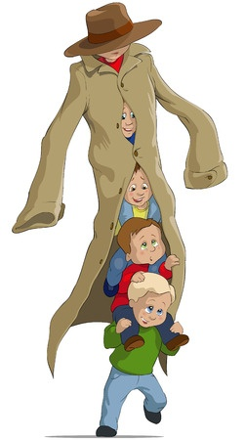
Compound Subject
Two or more nouns taking the same predicate or group of predicates
Examples
Johnny, Jimmy, Timmy, Tommy
and Bobby walked to the ticket
window at the movie theater.
The ticket clerk and her manager
would not sell them tickets to the
R-rated movie.

Slide 9
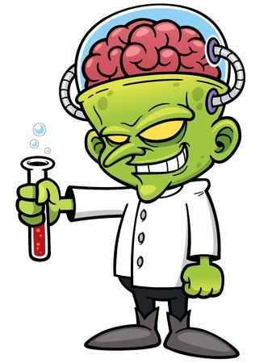
Independent Clause
A subject and predicate that work together and express a complete thought
Examples
Dr. Brain developed a powerful mind
control serum.
Dr. Brain poisoned Cityville’s
water supply with it.

Slide 10
Dependent Clause
A subject and predicate that work together and do not express a complete thought
Examples
Although Dr. Brain developed a
powerful mind control serum
After Dr. Brain poisoned
Cityville’s water supply with it
Conjunctions make clauses dependent

Slide 11

Dependent Clauses Need An Independent Clause
Or else it’s a sentence fragment
Examples
Although Dr. Brain developed a powerful
mind control serum, Super Dad does not
have enough mind to control.

Slide 12
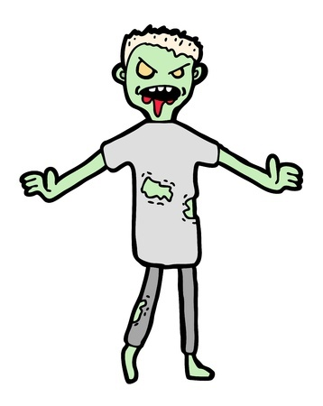
Sentences Can Have Many Clauses
New clauses begin at conjunctions or when new subjects are introduced
Example
I want to eat your brains, but I can’t run
very fast because I hurt my foot when
I was chasing someone else, so
please (you) slow down a little bit, ahhh.

Slide 13

More Examples of Clauses
Pandas defend themselves with their sharp claws and powerful jaws.
What is the subject and predicate
in this clause?
defend (predicate)
Panda (subject)

Slide 14
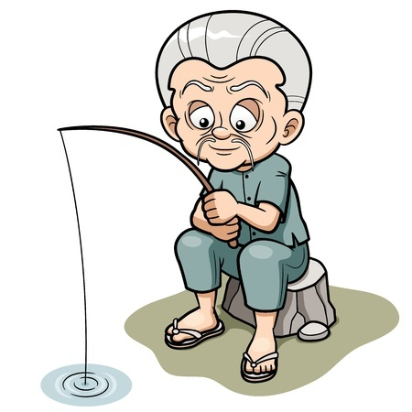
More Examples of Clauses
Harry fishes all day even though he never catches anything.
Which clause is dependent?
even though he never catches
anything

Slide 15

More Examples of Clauses
Argh, we shall land our boat ashore, find tailors and seamstresses, and repair our tattered garments, mateys!
How many predicates does the
above sentence have?
How many clauses does it have?
Even though it has three
predicates, it only has one clause.

Slide 16
Review
Predicates are verbs and subjects are nouns or pronouns that take a predicate.
Clauses are subjects or groups of subjects and predicates or groups of predicates working together.
Dependent clauses have a conjunction, do not express a complete thought, and need to be connected to an independent clause.

