Slide 1
Action Verbs & Verbs of Being

Slide 2
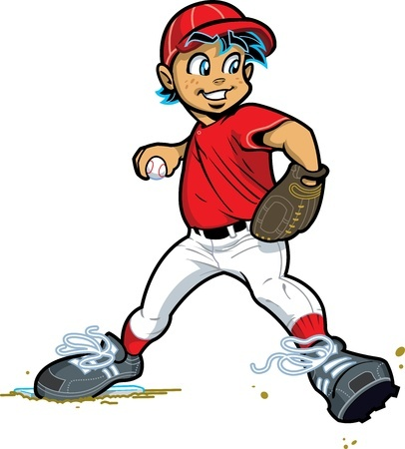
Verbs
Express an action or a state of being
Every sentence has one.
Examples
skate
She skates.
throws
The pitcher throws the ball.
goes
He goes to school.
was
She was sad.

Slide 3
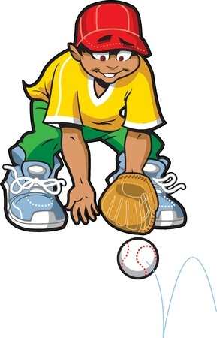
Action Verbs
Words that express actions
Examples
Bobby studies the map.
Emilio caught the ball.
Felicia skated at the ice rink.

Slide 4
Verbs of Being
Express a state of being
Examples
Jamie was curious.
Dr. Evil’s secret lair is on an oil rig deep at sea.
Football can be dangerous.

Slide 5
Forms of Be
Be changes based on time & perspective.
Am, is, are, was, were, be, being, been, has, have, had, will be, has been
I am.
[He, She, It] is.
[You, They, We] are.

Slide 6
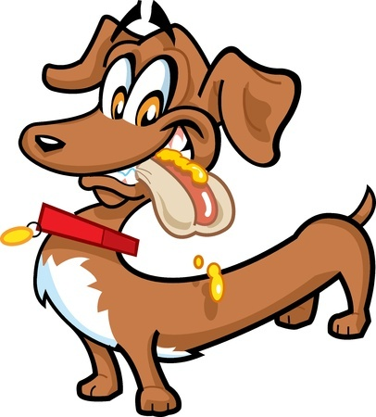
More Examples of Action Verbs and Verbs of Being
The hot dog dog loves hot dogs.
What is the verb in the above sentence?
loves

Slide 7
More Examples of Action Verbs and Verbs of Being
Claude moved and grooved on the dance floor.
What is the verb in the above sentence?
moved and grooved

Slide 8
More Examples of Action Verbs and Verbs of Being
Terry is an amazing golfer.
What is the verb in the above sentence?
is

Slide 9
Review
Verbs show actions or states of being.
Action verbs are things that you can do.
Verbs of Being are forms of be.
Am, is, are, was, were, be, being, been, has, have, had, will be, has been

