Slide 1

Capitalization

Slide 2
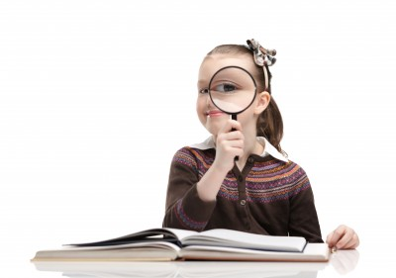
Overview
The Three Things to Capitalize:
Proper Nouns
Titles and Headings
First Word in a Sentence & the Pronoun I

Slide 3
Proper Nouns
Specific people, places, things, & brands
Always capitalize proper nouns.
Ex: Matthew, Chicago, Kleenex
Common Nouns
General people, places, and things
Usually DON’T capitalize common nouns.
Ex: kid, city, tissue

Slide 4
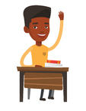
Quick Practice
I’m going to show you a noun.
You will...
1. Decide whether each is common or proper
2. If the word is proper, turn it common.
3. If the word is common, turn it proper.

Slide 5
5 Quick Practice Words
Eiffel Tower
teacher
car
Africa
language

Slide 6
Suggested Answers
1. Eiffel Tower
Proper noun (monument)
2. teacher
Common noun (Mr. Morton)
3. car
Common noun (Ford Escort)
4. Africa
Proper noun (continent)
5. language
Common noun (English)

Slide 7
Titles and Headings
Capitalize words in a title or heading.
Don’t capitalize “little words”
(Articles [the], conjunctions [and], or prepositions [in]).
Examples
We read Lord of the Flies.
I listened to “The Marriage of Figaro” by Mozart.
Many presidents have met with Prime Minister May.

Slide 8
Class Titles
Specific course titles (proper nouns):
1. I am in Earth Science 101.
2. I take Algebra 1 and English Literature 2.
General course titles (common nouns):
1. I like Earth science.
2. I like English literature more than algebra.
Capitalize proper nouns everywhere.

Slide 9
First Word and I
Always capitalize the first word in a sentence and the pronoun I.
Examples
We left.
Then Tim said, “Do you get it?”
So I said, “Yes, I get it.”

Slide 10
Review
Capitalize These:
Proper Nouns (Including brand names)
Titles and Headings (except “little words”)
First Word in a Sentence & the Pronoun I

Slide 11
Practice
Correctly capitalize each sentence.
Write a letter under each capitalization you make.
A – it’s a proper noun
B – it’s a word in a title
C – it’s the first word or the pronoun I

Slide 12
tom ran to the harold washington library.
he met with chief librarian roberts, the woman who ran the whole library.
tom was good at math but was getting a low grade in his reading 101 course.
the chief librarian helped tom research apple iphones for his report.
tom said, “thanks for the help with my reading class.”

Slide 13
Answers
Tom ran to the Harold Washington Library.
^{A, C} ^{A}
2. He met with Chief Librarian Roberts,
C B A
the woman who ran the whole library.
3. Tom was good at math but was getting a low
^{A, C}
grade in his Reading 101 course.
^{A, B}

Slide 14
Answers Continued
4. The chief librarian helped tom research apple
C A A
iPhones for his report.
^{A, ?}
5. Tom said, “Thanks for the help with my
A, C A
reading class.”

